Slide 1
Modern Slavery
–
General awareness information for professionals who may come into contact with victims of slavery and human trafficking.

Slide 2
Topics covered in this presentation
What is Modern Slavery?
Recognising the signs and indicators
Reporting your concerns
Common Myths about Modern Slavery
Further sources of help and advice
Notes:
What is Modern Slavery? We won’t get too technical and law based, just a brief overview.
Signs and Indicators- the most important part of the day. If you don’t recognise it you can’t do anything about it
Who do you report to?
Misconceptions
Where to get more help.

Slide 3
What is modern slavery?
Modern Slavery is a serious crime that violates human rights. Victims are forced, threatened or deceived into situations of subjugation, degradation and control which undermine their personal identity and sense of self.
Notes:
The photos are two typical situations., Criminal Exploitation and Labour Exploitation

Slide 4
What is modern slavery?
Modern Slavery encompasses:
slavery, servitude and forced or compulsory labour
human trafficking
The essence of Modern Slavery is that the victim is coerced or deceived into a situation where they are exploited.
Often the exploitation is for financial gain, but not always.

Slide 5
What is modern slavery?
Slavery, Servitude and Forced or Compulsory Labour
Slavery and servitude are aggravated forms of forced or compulsory labour.
Notes:
The 1926 Slavery Convention defines slavery as -
‘the status or condition of a person over whom any or all of the powers attaching to the right of ownership are exercised’.
It is a form of servitude with the additional concept of ownership.
Servitude -
An obligation to provide a service that is imposed by the use of coercion.
Servitude is an ‘aggravated’ form of forced or compulsory labour. The fundamental distinguishing feature between servitude and forced or compulsory labour is in the victim feeling that their condition is permanent and that the situation is unlikely to change.
UN Convention No. 29 defines forced or compulsory labour as –
‘all work or service which is exacted from any person under the menace of any penalty and for which the said person has not offered himself voluntarily’.

Slide 6
What is modern slavery?
Human Trafficking
When a person arranges or facilitates the travel of another person, with a view to that person being exploited. (includes recruiting, transporting, transferring, harbouring, receiving, exchanging control of the person)
It is irrelevant whether that person (adult or child) consents to the travel.
Travel means arriving in or entering any country, departing from any country, travelling within any country.
Notes:
Section 2 Human trafficking
(1) A person commits an offence if the person arranges or facilitates the travel of another person (“V”) with a view to V being exploited.
(2) It is irrelevant whether V consents to the travel (whether V is an adult or a child).
(3) A person may in particular arrange or facilitate V’s travel by recruiting V, transporting or transferring V, harbouring or receiving V, or transferring or exchanging control over V.
(4) A person arranges or facilitates V’s travel with a view to V being exploited only if:
(a) the person intends to exploit V (in any part of the world) during or after the travel, or
(b) the person knows or ought to know that another person is likely to exploit V (in any part of the world) during or after the travel.
(5) “Travel” means:
(a) arriving in, or entering, any country,
(b) departing from any country,
(c) travelling within any country.
(6) A person who is a UK national commits an offence under this section regardless of:
(a)where the arranging or facilitating takes place, or
(b)where the travel takes place.
(7) A person who is not a UK national commits an offence under this section if:
(a) any part of the arranging or facilitating takes place in the United Kingdom, or
(b) the travel consists of arrival in or entry into, departure from, or travel within, the United Kingdom.
Section 3 Meaning of exploitation
For the purposes of section 2 a person is exploited only if one or more of the following subsections apply in relation to the person.
Slavery, servitude and forced or compulsory labour
(2) The person is the victim of behaviour:
(a) which involves the commission of an offence under section 1, or
(b) which would involve the commission of an offence under that section if it took place in England and Wales.
Sexual exploitation
(3) Something is done to or in respect of the person:
(a) which involves the commission of an offence under:
(i) section 1(1)(a) of the Protection of Children Act 1978 (indecent photographs of children), or
(ii) Part 1 of the Sexual Offences Act 2003 (sexual offences), as it has effect in England and Wales, or
(b) which would involve the commission of such an offence if it were done in England and Wales.
Removal of organs etc.
(4) The person is encouraged, required or expected to do anything:
(a) which involves the commission, by him or her or another person, of an offence under section 32 or 33 of the Human Tissue Act 2004 (prohibition of commercial dealings in organs and restrictions on use of live donors) as it has effect in England and Wales, or
(b) which would involve the commission of such an offence, by him or her or another person, if it were done in England and Wales.
Securing services etc. by force, threats or deception
(5) The person is subjected to force, threats or deception designed to induce him or her:
(a) to provide services of any kind,
(b) to provide another person with benefits of any kind, or
(c) to enable another person to acquire benefits of any kind.
Securing services etc. from children and vulnerable persons
(6) Another person uses or attempts to use the person for a purpose within paragraph (a), (b) or (c) of subsection (5), having chosen him or her for that purpose on the grounds that:
(a) he or she is a child, is mentally or physically ill or disabled, or has a family relationship with a particular person, and
(b) an adult, or a person without the illness, disability, or family relationship, would be likely to refuse to be used for that purpose.

Slide 7
What is modern slavery?
Modern Slavery can happen in wide variety of settings and industries. Depending on the setting, Modern Slavery is often referred to by typology.
What are the most common types seen in the UK?
Whilst victims of different types of exploitation may present very differently, they are all victims and must be treated with compassion.
Notes:
Sexual exploitation
Child sexual exploitation
Labour exploitation
Financial exploitation
Domestic servitude
Sham/forced marriages
Coerced Criminality (also known as Forced Criminality)
Trafficking for Organ Removal (not in the UK yet?)

Slide 8
What is modern slavery?
Main areas of Legislation:
Modern Slavery Act 2015
Gangmasters (Licensing) Act 2004
Immigration Act 2016
Notes:
The Modern Slavery Act 2015 – In addition to the details in slide 4, MSA 2015 gives law enforcement agencies the tools to tackle modern slavery, including maximum life sentences for perpetrators and enhanced protection for victim. STPOs and STROs
Gangmasters (Licensing) Act 2004 – created the Gangmasters Licensing Authority and established a licensing scheme which regulated the supply and use of labour in agricultural, horticulture, shellfish gathering, food processing and packaging sectors to protect workers from exploitation
Trainer Note: Briefly explain what the GLAA are, including the term gangmaster and the licenced sector
Immigration Act 2016 – reforms labour market landscape, creating a role of Director of Labour Market Enforcement, expands the remit of the GLA (renaming them the Gangmasters and Labour Abuse Authority) giving them police powers to investigate labour exploitation across all sectors of the labour market (not just the licensed sectors) and new tools to tackle businesses who deliberately or repeatedly break the law (through labour market enforcement undertakings and orders)

Slide 9
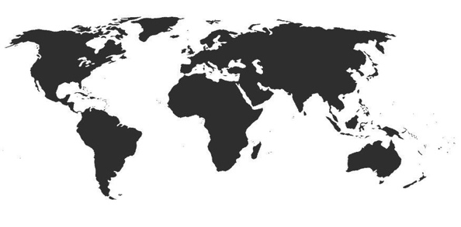


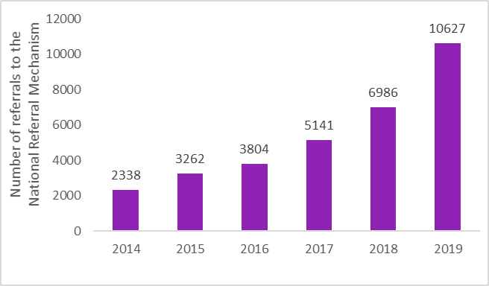



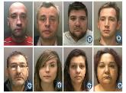

Modern Slavery: Facts and Figures
Home Office estimated 10,000-13,000 potential victims of modern slavery in the UK in 2013
Total social and economic cost to UK of modern slavery in 2016/17 was £3.4 - 4.3 billion
Estimated 40.3 million modern slavery victims globally in 2016
Scale
Average cost per modern slavery crime: £328,720
10,627 potential victims referred to UK NRM in 2019. 43% exploited as children.
1. UK is the most common reported nationality (2,870* potential victims +1,211 referrals on 2018)
In Q1-Q3 2019, labour was the most common exploitation type (4,727)
In Q4 2019, criminal exploitation was reported separately to labour for the first time. This showed:
Labour exploitation was most common for adults (657)
Criminal exploitation was most common for minors (664)
Victims
2. Albania (1705)
3. Vietnam (887)
4. China (798)
5. India (469)
6. Eritrea (468)
7. Sudan (373)
Includes dual-nationals
Case study: Europe’s largest slavery ring
7,283 modern slavery offences recorded in 2019, increase of 67% on offences recorded in 2018
Polish crime gang recruited vulnerable Poles to the UK
400 suspected victims forced to work in agricultural and recycling sectors
Bank accounts and benefits controlled by gang – £2m profits generated, victims paid as little as 50p a day
8 gang members sentenced to 3-11 years
Offenders
349 prosecutions for modern slavery offences 2019, increase of 19% on prosecutions in 2018
170 Slavery and Trafficking Prevention and Risk Orders granted since 2016 to prevent modern slavery

Slide 10
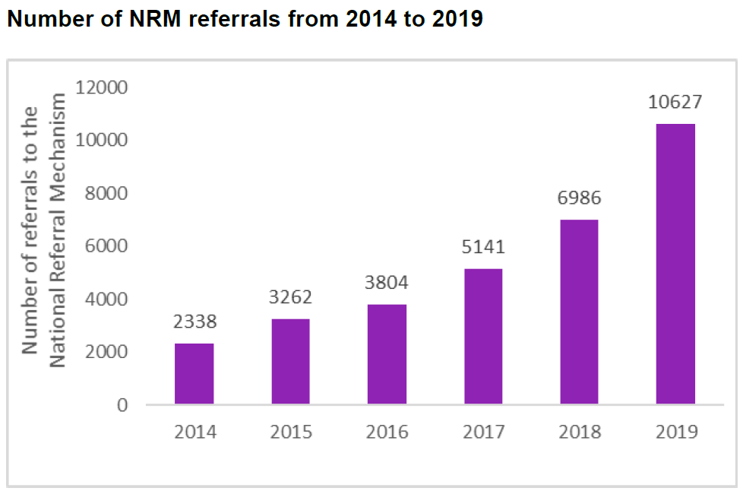
What is modern slavery?
Notes:
Just over half (5,866) of the referrals were for individuals who were potentially exploited as adults, whilst 43% (4,550) were for potential victims who were exploited as minors. Of the potential victims referred in 2019, one-third (3,391) were female; two-thirds (7,224) were male.
The most common nationality of all referrals to the NRM in 2019 was UK nationals, accounting for 27% (2,836) of all potential victims. The second most commonly referred nationality was Albanian (1,705 referrals) followed by Vietnamese nationals (887 referrals).
Labour, sexual and criminal exploitation account for majority of NRM referrals.

Slide 11
What is modern slavery?
The following video called ‘Horse Trading’, produced by the Gangmasters and Labour abuse Authority (GLAA), describes a form of labour exploitation.
Click on the below to watch the video (10 minutes)
https://www.youtube.com/watch?v=k-I5EtcewdM
Links to more resources can be found in the section ‘Further sources of help and advice’
Notes:
An example of Labour Exploitation.

Slide 12
What is modern slavery?
The following video was produced by Lancashire Police and describes sexual exploitation and investigation undertaken by the police
Click on the below to watch the video (7 minutes)
https://www.youtube.com/watch?v=9ywPfLxnrak&feature=youtu.be
Links to more resources can be found in the section ‘Further sources of help and advice’
Notes:
Ask the question “What if the Women are willing sex workers? Does that make a difference?”

Slide 13
Signs and Indicators
This section will look at;
Some of the locations where victims are found.
The indicators of exploitation.
The barriers victims may experience to reporting.
Notes:
It is important to remember that victims of Modern Slavery will present in many different ways and at a variety of locations.
Some victims may not realise they are being exploited and some will be too frightened to talk openly about their situation to law enforcement.
They might speak to an NGO or charity.

Slide 14
Signs and indicators
Where are some of the locations that victims are encountered?
Car washes
Restaurants
Nail bars
Traveller sites
Factories
Brothels
Private dwellings
Farms
Cannabis farms & drug supply
Care homes
Vegetable picking
Fishing industry
Building sites
Cleaning companies
Employment agencies
Begging
Notes:
Ask for examples from the audience before revealing the examples on the slide.

Slide 15
Signs and indicators
What are the indicators of exploitation?
Illegal entrant
No passport or ID
Limited social contact
Bonded by debt
Restriction on movement
Lack of access to medical care
Poor accommodation
Money deducted from salary for food or accommodation
Unexplained injuries
Dependent on others
Working in location likely to be involved in exploitation
Poor language skills
Vulnerable person i.e. homeless, substance dependent
Being controlled by another
Threats of being handed over to authorities
Unable or reluctant to give details of accommodation
Notes:
Ask for examples from the audience before revealing the answers. Ask them to think of examples from their own areas of work

Slide 16
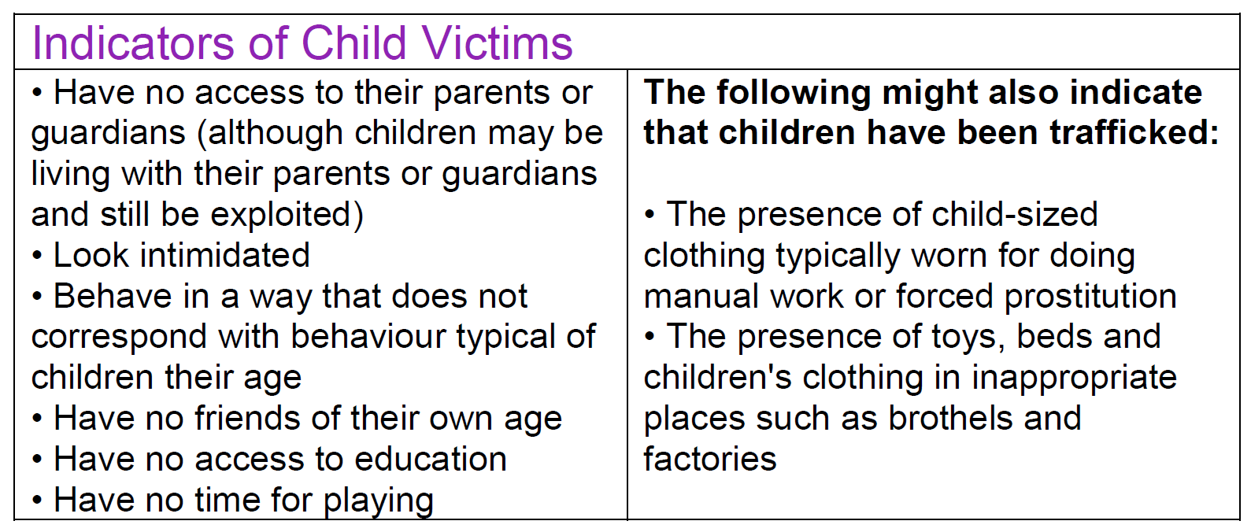
Signs and Indicators
Notes:
Child victims may be identified in a range of contexts. They may be UK citizens or migrant children.
Some children arrive in the UK accompanied by adults who are either not related to them or in circumstances which raise child protection concerns.
Child victims may find it particularly hard to disclose and are often reluctant to give information. This may be because their stories are made up by their trafficker or exploiter, or the traffickers may have given them inaccurate information about the role of authorities, and they may have had bad experiences with corrupt authorities during their journey if trafficked. As a result, they may relate their experiences in an inconsistent way or with obvious errors.

Slide 17
Signs and indicators
What are the barriers victims may experience to reporting?
Unaware they are a victim
Unaware help is available
Language barriers
Controlled movement
Fear of repercussions (family or themselves)
Always accompanied by a trafficker
Isolation
Feel they are better off in current rather than previous situation
Immigration status
Involvement in criminal activity
Juju (witchcraft)
Lack of trust in authorities
Self blame
Stigma
‘Stockholm syndrome’
Notes:
Ask the audience before revealing the slide

Slide 18
Signs and Indicators
Victims may not recognise themselves as a victim of modern slavery or be reluctant to be identified as such. It is important that First Responders and other frontline staff are aware of the indicators of modern slavery in order to help identify potential victims who are reluctant or unable to self-identify.
Notes:
Victims of modern slavery may initially be unwilling to disclose details of their experience or identify themselves as a victim for a variety of reasons.
Recognising the signs and indicators is probably the most important part of todays session.

Slide 19
Signs and Indicators
Victims are often described as being ‘hidden in plain sight’ and professionals must use there judgment and skill to spot potential victims.
Professionals who may encounter victims are encouraged to trust their instincts, if something doesn’t feel right - report it!
NCA Invisible People Campaign - photograph exhibition.

Slide 20
Reporting Concerns
The National Referral Mechanism
The National Referral Mechanism (NRM) is the framework by which potential victims of Modern Slavery are identified and supported.
Potential victims can be referred in to the NRM by a wide range of ‘First Responders’. Where potential victims are encountered by professionals who are not First Responders, they should be referred to a First Responder as soon as possible.
Remember - NRM support is not dependant on victims of Modern Slavery supporting a criminal investigation.
Notes:
(If necessary for further explanation “Identified” i.e. they receive a reasonable grounds decision from the SCA within 5 days and a conclusive grounds decision after 45 days which can lead to a further 45 days support, totalling 90 days.)

Slide 21
Reporting Concerns
The National Referral Mechanism
Adults must consent, Children do not have to consent.
Victims who enter the NRM are entitled to support
Does anyone know what type of support is available?
Full details of all support can be found in annexes F & G to the Home Office Statutory Guidance for England and Wales.
Notes:
Ask the audience for examples or … ask what they would expect to be provided.
Emergency accommodation
Outreach support
Financial support
Translation and interpretation services
Information on rights and services
Medical treatment, assistance and counselling
Access to the labour market, vocational training and education
Support in transitioning to alternative support servicesAccess to legal representation
Voluntary returns
Access to education for child victims

Slide 22
Reporting Concerns
Which agencies are First Responders?
In England and Wales, the agencies listed below are First Responders.
Public Authorities:
Police
Gangmasters and Labour Abuse Authority (GLAA)
National Crime Agency (NCA)
Local Authorities
Immigration Enforcement (IE)
Border Force
UK Visa and Immigration
Charities:
Barnardo’s
BAWSO
Kalayaan
Medaille Trust
Migrant Help
New Pathways
NSPCC
Refugee Council
The Salvation Army
Unseen UK

Slide 23
Reporting Concerns
Any First Responder must notify the Home Office about when they encounter a potential victim of Modern Slavery.
This is usually done when that potential victim enters the NRM.
However, when an adult victim refuses the NRM the First Responder still has a Duty to Notify the Home Office of the existence of that potential victim so there is an accurate record of Modern Slavery in the UK.
Notes:
May get further questions about the DTN system.

Slide 24
Reporting Concerns
Which first responder should I approach?
The individual circumstances of the victim may mean a professional encountering a victim feels it is more appropriate to approach a particular First Responder. (e.g. a child)
Remember, whilst any First Responder can refer a victim into the NRM, only law enforcement agencies can investigate Modern Slavery.
If you are in doubt about which First Responder to contact, it is advisable to contact the police. If the individual is in immediate risk, you must always contact the police using 999.

Slide 25
Reporting Concerns
Reporting concerns to the police
The police will always prioritise the safety of a potential victims over anything else.
Victims can speak to the police in confidence and will be given time to decide if they wish to support a criminal investigation by providing a statement and attend potentially attend court at a later date. Police can still investigate Modern Slavery without the need for victims to provide a statement or go to court.
If the potential victim is worried about speaking to authorities, then the professional who identified the potential victim may be asked to assist in facilitating engagement between the police and the victim.
Notes:
Explain Evidence Based Policing in lay mans terms, use of surveillance, intelligence from partner agencies, CCTV, Financial Data, Phone Data, Social Media evidence. As seen in the Lancs Police Sexual Exploitation video.

Slide 26
Reporting Concerns
Reporting concerns to the police…(cont.)
When making a report to the police it is important to distinguish between intelligence and a Modern Slavery report, which is in effect the report of a crime.
When making a Modern Slavery report to the police, the person making the report will be expected to provide basic details, including the name of the potential victim, and a means by which they can be safely contacted (this can be via the reporting person in the first instance).
Less specific information can be passed to the police as intelligence. Whilst this will help the police, it may not result in immediate safeguarding or an NRM referral for an individual.

Slide 27
Reporting Concerns
Concerns about Labour Exploitation
GLAA - Contact details
By telephone - 0800 432 0804, to report your concerns in confidence. Lines are open Monday to Friday 9:00am - 5:00pm, You can also call 0115 959 7049 (and leave a message outside of office hours
By email - intelligence@gla.gov.uk, please give them as much information as you can.

Slide 28
Reporting Concerns
Concerns about non payment of National Minimum Wage
ACAS -
Acas helpline - Pay and work rights helpline and complaints Telephone: 0300 123 1100 Monday to Friday, 8am to 6pm
https://www.gov.uk/pay-and-work-rights

Slide 29
Reporting Concerns
HMRC - National Minimum Wage enquiries and complaints
Online complaints - https://www.gov.uk/government/publications/pay-and-work-rights-complaints

Slide 30
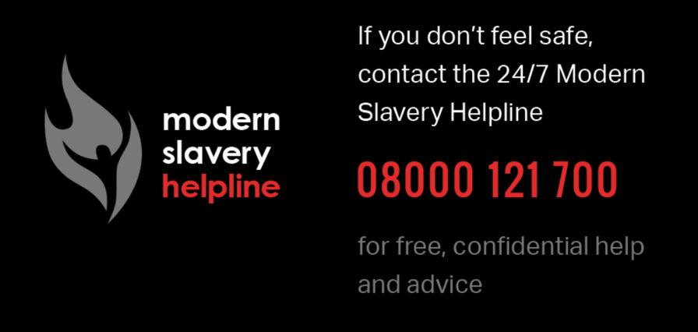
Reporting Concerns
Modern Slavery Helpline 08000 121 700
The Modern Slavery Helpline provides a 24/7 service to victims and people who may come into contact with victims.
For professionals who are unsure whether a person they have come into contact with is a victim, this is an invaluable resource to be able to talk through the circumstances with an expert, who can then provide advice on what steps should be taken. In an emergency or where there is immediate risk the police should be called on 999.
"The Modern Slavery Helpline is a unique one-stop phone number for everything from general enquiries to reporting actual or suspected abuse. One phone call to the Modern Slavery Helpline creates the opportunity for anyone to add their own eyes and ears to thousands of others and help bring an end to modern slavery in the UK” James Ewins QC, Ambassador for the Modern Slavery Helpline
Notes:
Caviate that they may be about to lose their funding. Good to use them at the moment.

Slide 31
Common Myths about modern slavery
Myth | Reality
The person did not take opportunities to escape so is not being coerced. | Remaining in an exploitative situation could indicate a willingness to remain there and/or an absence of coercion. But there are many reasons why someone may choose not to escape an exploitative situation, for example: • fear of reprisal against the person or family members • vulnerability • Stockholm syndrome (psychological dependency on the person exploiting them) or grooming • lack of knowledge of their environment • belief that the trafficker or exploiter will fulfil their promise • fear of witchcraft • violence or threats of violence • not knowing how and where to seek help

Slide 32
Common Myths about modern slavery …. (cont.)
Myth | Reality
UK nationals cannot be victims of modern slavery. | UK nationals can and have been victims of modern slavery.
Crossing a border is required in order to be trafficked. | Trafficking does not have to occur across borders; it can occur within a country.
It cannot be modern slavery when organiser and victim are related, married, living together or lovers. | Close relationships are often used to exploit and control others. This is especially relevant in child modern slavery. There have been numerous incidents where ‘boyfriends’ have groomed women and children into sexual exploitation or family members have colluded (intentionally or unintentionally) in the exploitation.

Slide 33
Common Myths about modern slavery …. (cont.)
Myth | Reality
A person is not a victim of modern slavery when they say they have a better life than previously. | Some people are willing to tolerate their situation because they may perceive it as a ‘stepping stone’ to a better future and may compare it favourably to experiences at home. This doesn’t mean they are not a victim of modern slavery.
A person is not a victim of modern slavery when they reject an offer of help. | It is not uncommon for victims to reject offers of help at first. This is not unique to victims of modern slavery.

Slide 34
Further sources of help and advice
Home Office published guidance and information on Modern Slavery - https://www.gov.uk/government/collections/modern-slavery
Home Office training material - https://www.gov.uk/government/publications/modern-slavery-training-resource-page/modern-slavery-training-resource-page
Modern Slavery Police Transformation Unit (MSPTU) - https://www.policingslavery.co.uk/
MSPTU links to further video resources - https://www.policingslavery.co.uk/policing-modern-slavery/video-resources/
Gangmasters and Labour Abuse Authority (GLAA) - https://www.gla.gov.uk/

Slide 35
Further sources of help and advice…(cont.)
Barnardo’s - https://www.barnardos.org.uk/what-we-do/protecting-children/trafficked-children
BAWSO - http://www.bawso.org.uk/
Kalayaan - http://www.kalayaan.org.uk/about-us/what-we-do/
NSPCC - https://learning.nspcc.org.uk/
The Medaille Trust - https://www.medaille-trust.org.uk/
Migrant Help - https://www.migranthelpuk.org/
New Pathways - http://www.newpathways.org.uk/
Refugee Council - https://www.refugeecouncil.org.uk/
The Salvation Army - https://www.salvationarmy.org.uk/modern-slavery
Unseen UK - https://www.unseenuk.org/

Slide 36
This presentation has been created by the Home Office Modern Slavery Unit, in collaboration with the Modern Slavery Police Transformation Unit.

